Slide 1
2019 Legal Update for Special Education Administrators
Susan Goldammer
Missouri School Boards’ Association
Goldammer@mosba.org

Slide 2
House Bill 604 (2019)
Omnibus bill
Started out as a bill focused on student safety but quickly turned into much, much more.
Unless noted otherwise, the new laws came from this bill.

Slide 3
School Start Date: §171.031
Beginning in the 2020-21 school year, school districts cannot start earlier than 14 calendar days prior to Labor Day.
2020: August 24
2021: August 23
No hearings, no exceptions.
Will this increase tourism dollars?
Will more people go to the State Fair?

Slide 4
More Board Training: §162.203
New school board members must receive an additional 2.5 hours of training the first year of service on identifying signs of sexual abuse in children and potentially abusive relationships between children and adults.
All Board members must also complete one hour of refresher training for every additional year they are in office on preventing sexual abuse of children.

Slide 5
More Student Training: §170.045
Beginning in the 2020-21 school year, school districts must provide trauma-informed, developmentally appropriate training regarding sexual abuse to students in all grades, 6-12.
Recognize abuse
How to report
How to ask for help
Resources for students impacted
Must notify parents or guardians of the content of the instruction and allow them to opt the student out.

Slide 6
Screening Employees/Sexual Misconduct: §162.068
Before offering employment to a teacher, districts and charter schools must contact DESE for a list of districts or charter schools for which an applicant previously worked.
Districts are required to contact the most recent school district or charter school for references, including information on if they left due to sexual misconduct.
Should do for all employees!
Tip: Ask for person at district designated to give the official reference on behalf of the district.

Slide 7
Most Important Reference Question
If given a choice,
would the district/employer
hire this person again?

Slide 8
Sharing Sexual Misconduct: §162.068
If employee leaves due to crime of “sexual misconduct” under §566.083, RSMo. with a student, the district’s designated person must share when asked for a reference.
If violation of a Board policy “related to sexual misconduct,” the district’s designee must share after a contested case hearing before the Board.
Problem: More restrictive than previous law!

Slide 9
Employees and Child Abuse: §210.110
Expands the definition of person responsible for the “care, custody, and control” of a child under the child abuse and neglect laws.
Now explicitly includes school personnel, contractors and volunteers if the relationship with a child was established through the school or school-related activities, “even if the alleged abuse or neglect occurred outside of school hours or off school grounds.”

Slide 10
Volunteers and Background Checks: §168.133
Requires volunteers who may periodically be left alone with a student or have access to student records to receive a criminal background check like employees.
Requires same fingerprint background check that employees receive!
Problem: Expensive and could exclude poor parents from volunteering unless district subsidizes.

Slide 11
2019 Legislative Message
Too much sexual abuse of students
and we want school districts to
do something about it!

Slide 12
Avoiding Make-Up Days: §171.033
Your district may develop an alternative method of instructing students in situations where school is cancelled.
Virtual instruction, etc.
Plan must first be approved by DESE.
You cannot use it for more than 36 hours of instruction.
Good: Allows for flexibility and creativity.
But: Are there alternative methods that work for all of your special needs students?

Slide 13
A+ Scholarship: §160.545
High school students may use A+ scholarship funds (if they exist) for the cost of tuition and fees for dual credit or dual enrollment courses.
Funding will be based on financial need.
Must have attended a Missouri high school for at least two years and meet the eligibility requirements immediately prior to taking the course.
Problem: High school students will receive reimbursements last, so availability depends on appropriation.

Slide 14
Teacher Externships: §160.025
DESE and the Department of Economic Development will create requirements for business externships.
If a teacher participates in an externship that meets the requirements, he or she will be allowed movement on the salary schedule in the same manner as if they earned graduate hours.
DESE will determine how many hours.

Slide 15
Bidding Construction: §177.086
Previously: Required to formally bid construction projects that may exceed $15,000.
Now: Threshold is $50,000.
MSBA is also recommending that districts raise their sealed bidding threshold for other purchases too.

Slide 16
School Turnaround Expert: §161.1080 - .1130 Who Is Making Money?
Beginning September 1, 2020, DESE will identify schools in need of intervention.
District committee selects an independent school turnaround expert approved by DESE to work with the committee to create a school turnaround plan.
DESE pays the turnaround expert an average of $650,000 per project, which may be differentiated based on student enrollment, and increased for schools in the lowest-performing one percent of schools.
Subject to appropriation (thank goodness).

Slide 17
Elementary Pilot Programs: §§170.020, 170.086
Requires DESE to establish a voluntary pilot program to provide:
Social and emotional health education in a minimum of 16 elementary schools.
Agricultural education in a minimum of 16 elementary schools.
DESE is required to hire enough regional staff to run programs.
Will take applications from districts that want to participate.

Slide 18
Social and Emotional Health Surveys
Don’t forget the Protecting Pupil Rights Amendment (PPRA)!
Federal law governing the collection of specific data from students.
If survey is funded with federal dollars, you must get written consent of the parents prior to administering.
If funded differently, must give parents notice and an opportunity to opt out of the survey.
Policy JHDA: Surveying, Analyzing or Evaluating Students

Slide 19
PPRA Applies If Asking About . . .
Political affiliations or beliefs?
Mental or psychological problems?
Sex behavior or attitudes?
Illegal, antisocial, self-incriminating or demeaning behavior?
Critical appraisals of student’s family?
Legal relationships with lawyers, physicians and ministers?
Religious practices, affiliations or beliefs?
Income, for reasons other than eligibility in lunch or other programs?

Slide 20
Religion: §160.2500
Districts cannot discriminate against any person on the basis of religious viewpoint or religious expression.
Never could!
Senate Concurrent Resolution 13: Encourages (does not require) districts to offer a Bible course as a social studies elective in high school.
Always could!

Slide 21
Early Childhood and State Aid: §163.018
Allows school districts and charter schools that contract for early childhood education services (instead of providing it directly) to collect state aid for attendance if state standards set by the State Board of Education are met.
Full-day and full-year programming?
Teacher-to-child ratios?
Professional development for educators?
Credentialed educators?
DESE-approved curriculum that is developmentally appropriate?

Slide 22
Military Student Remote Enrollment: Senate Bill 306
§167.020
If one or both of a child's parents are being relocated to Missouri under military orders, the district must allow remote registration of the student.
Physical presence not required to enroll.
Parents do not need to provide proof of residency until 10 days after the student’s attendance.

Slide 23
CBD and Students
Legal under state and federal law.
One prescription form of CBD is approved by the FDA to treat seizures.
§195.207: Only parents/guardians with registration cards can administer to minor students.
106 cards issued for 87 children so far.
Policy JHCD: CBD will not be administered to minors. May administer to students 18 or older if using FDA-approved medication.

Slide 24
Medical Marijuana in Schools
While legal under state law, it is not legal under federal law.
Do not put staff at risk by requiring that they administer.
Policy JHCD: Not allowed.
19 CSR 30-95.030: “Non-emancipated patient under the age of 18”: Only the patient’s parent or guardian can purchase or possess marijuana for the child.
What if the student is “emancipated”? Still not allowed at school!

Slide 25
PII and Expenditures: §160.066
Beginning September 1, 2019, districts are required to post on the district’s website “a searchable expenditure and revenue document or database detailing actual income, expenditures, and disbursements for the current calendar or fiscal year.”
Exception: Records protected from disclosure by law
Bookkeepers are trying to use existing bill listings
Problem: Disclosing confidential information on specific special education students. Be careful!

Slide 26
MO Course Access Program (MOCAP): §161.670
Course providers register with DESE.
587 courses listed so far, 5-12
K-12 students are entitled to take courses at district’s expense unless it is “not in the best educational interest” of the student.
If district says no, parents can appeal to the Board and then to DESE.
Make sure you document why the district made its decision!

Slide 27
MOCAP and Special Education
Policy IGCD: Virtual Courses
IEP team determines whether it is appropriate for a special education student to take virtual courses.
Also, what supports are necessary for students to take virtual courses?
Appeals? Due process, not the school board (we think).

Slide 28
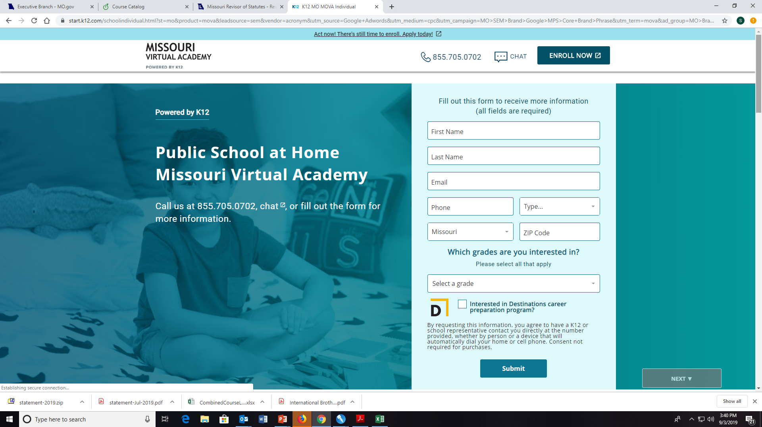

Slide 29
Fulton Lawsuit
K-12, Inc. (for-profit) contracts with Grandview R-II to provide summer school. Called Missouri Virtual Academy or MOVA.
Fulton School District (and others) refuse to do business with MOVA because it was not a MOCAP vendor at the time.
Lawsuit against DESE and Fulton to let them into MOCAP without signing paperwork because statute says that courses offered by school districts are automatically approved.
Court orders DESE to enroll MOVA into MOCAP.

Slide 30
DESE Assurances to be a MOCAP Vendor
Courses offered align with the Missouri Learning Standards
Comply with Web Content Accessibility Guidelines 2.1 (WCAG)
Closed captioning for videos, etc.
Submit the names of the instructors to ensure that they are Missouri certified.
Comply with reporting requirements, price cap, and payment methods as outlined in §161.671, RSMo.

Slide 31
“This ruling finally corrects the Fulton School District’s outrageous decision to deny the Estills the educational opportunities afforded to them under state law.”
Missouri Senator Bob Onder

Slide 32
“The process DESE has in place for MOCAP-approved courses is designed to ensure that virtual instruction meets state standards, provides properly certificated teachers, protects student privacy, and is accessible for students with disabilities. In view of the judge’s order, DESE will include MOVA and other programs requested by school districts or charter schools in MOCAP. A quality review of these courses and providers will occur after they are operational.”
DESE

Slide 33
It is Up to YOU!
It is up to YOUR district to make sure that these companies are doing right by your kids.
Do not sign anything they give you until it has been read by an attorney!
Do not pay until they sign a contract!
Follow the law, but provide facts to the parents so they can make good choices too. There are other virtual options!
Give DESE feedback on the quality of the courses.

Slide 34
It is Up to YOU!
Contract should require:
ADA accessible and special ed supports.
Only pay them monthly, not full amount up front.
FY 2020 tuition is capped at $892.50 for year-long course and $446.25 for semester.
Must use Missouri learning standards.
You can terminate enrollment if the course is “not meeting the educational needs of the student.”
Missouri certified teacher as instructor.
You cannot collect state aid otherwise!

Slide 35
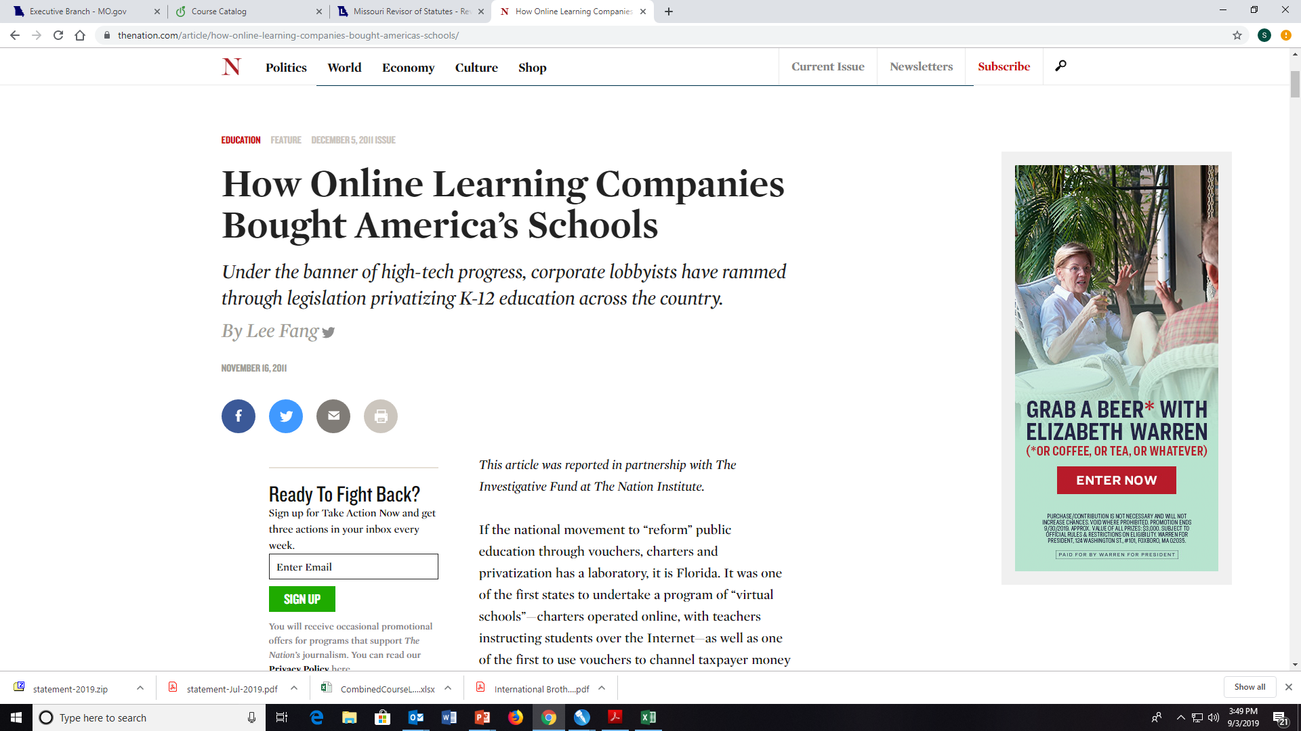

Slide 36
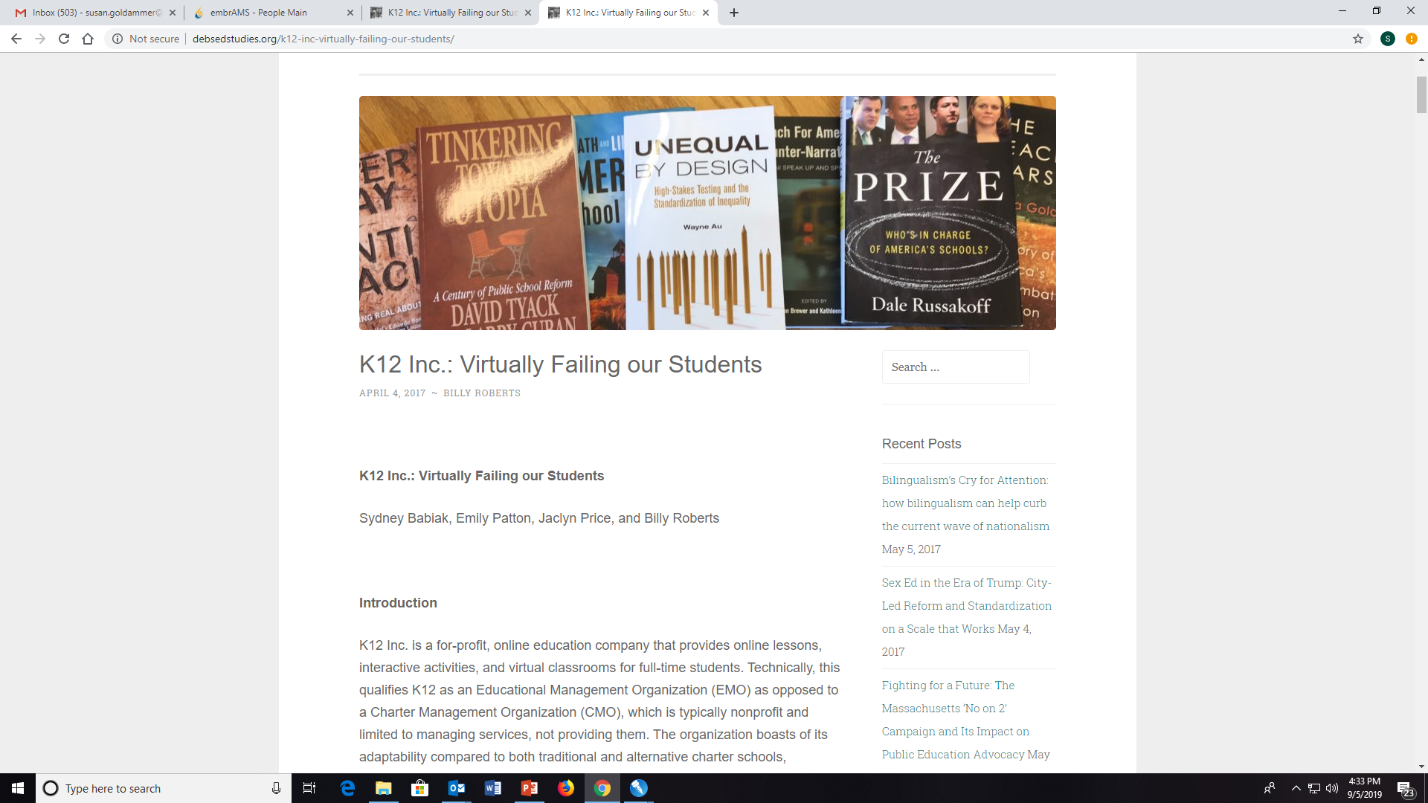

Slide 37
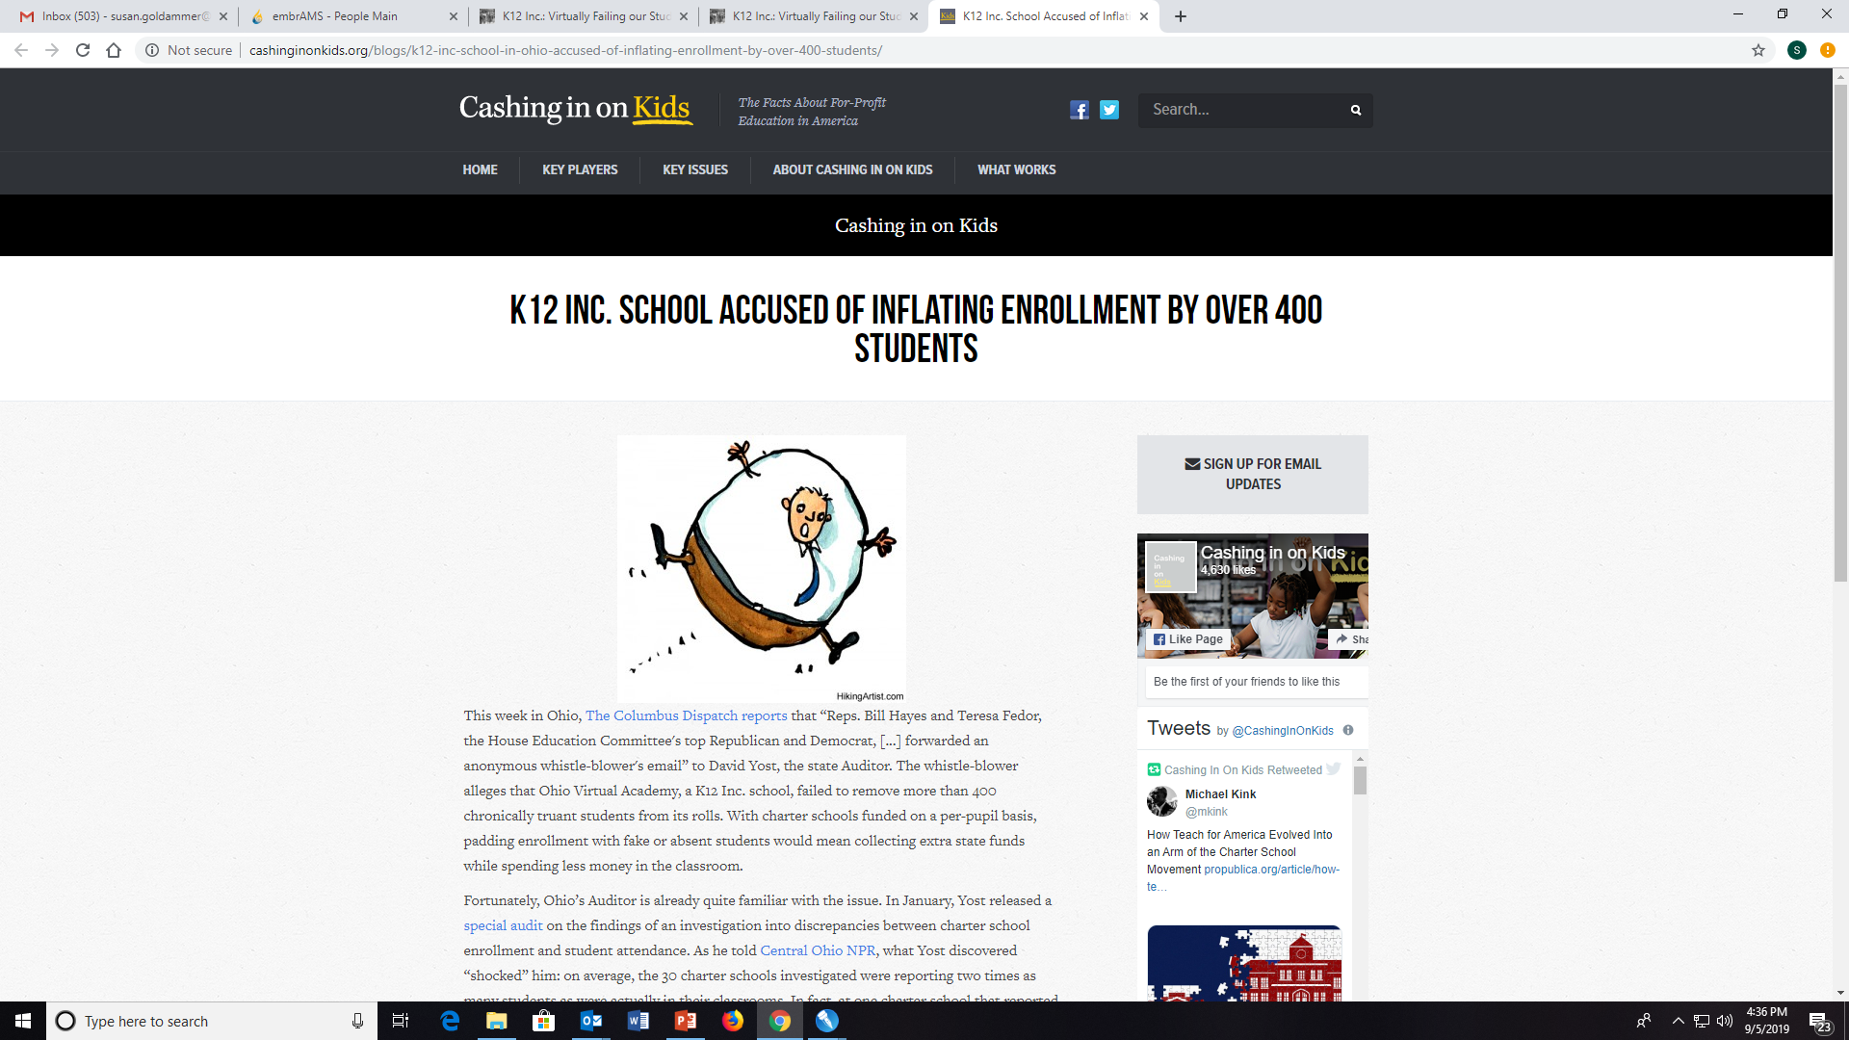

Slide 38
Courage2Report Missouri
School violence hotline for all Missouri schools
1-866-748-7047, toll-free
Online reporting
Mobile app
Staffed 24 x 7
Submitted tips are assessed for threat-level
Provided to school building contacts and law enforcement

Slide 39
Have the courage to report and make a difference! 1-866-748-7047

