Slide 1
Presented by the Farmington School District
September 2019
Missouri Model Districts & District Continuous Improvement

Slide 2
Welcome!
Dr. Ashley Krause, Associate Superintendent
Mr. Dan Thompson, Director of Special Education
Mrs. Shana Turner, Director of Elementary Education

Slide 3
The Bottom Line
CLOSE THE GAP FOR
ALL
STUDENTS
*Most students spend 80% of their time in a general education classroom

Slide 4
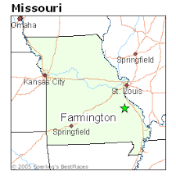
Farmington R7 School District
@ a Glance
8 Campuses
(Including Alternative School)
4,018 Students
338 Certified Staff Members

Slide 5
Session Objectives
Farmington School District’s Journey with Missouri Model Districts (MMD)- Where We Started & Where We Are Going
View of the Mo Edu Sail Website & Resources Available
View of the Virtual Learning Platform by DESE

Slide 6
The FSD Journey
Attended the MMD Summit in May/June of 2018
Each building principal was asked to think of 5 staff members that could help lead their staff forward in the 18-19 school year
High School (due to size) chose 7 staff members for their team
Teachers selected were told upfront this commitment would take extra time and they would be expected to present PD to their building staff once a month
The District Leadership Team is called the “Professional Growth Community”

Slide 7
Our Staff Commitment
Each member of the Professional Growth Community (PGC) was given information regarding their commitment.
PGC Commitment Agreement

Slide 8
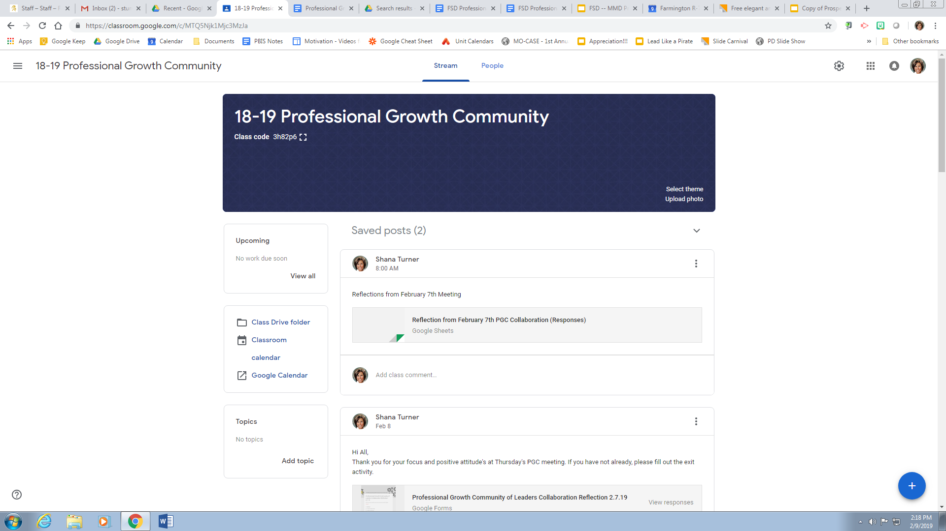
A Google Classroom is used to keep all PGC members informed, up to date and serves as a housing spot for all important information.

Slide 9
The Structure of PGC Meetings
Agenda Driven
Each PGC meeting begins with a “Reflect and Reconnect” activity as a whole group to get the team to focus and connect as an entire team.
Must Do/May Do
Each month listed on the agenda are items that PGC members “must do” and “may do” with their building on the early out PD day.
Team Time
After completing the “Reflect and Reconnect” and “Must Do”/”May Do” part of the agenda as a whole group, building teams split up into different areas of the building to plan out the next early out for their staff.

Slide 10
Sample Agendas from PGC Meetings
February Agenda
October Agenda
January Agenda
Notes:
Suggested by Steven

Slide 11
The Importance of Being United
At the end of each PD lead by PGC members, a Google form
reflection is completed by all staff members.
PGC members fill out a different Google form reflecting on how they thought the PD with their building went for the day.
The reflections are shared with building admin each time
from both groups.

Slide 12
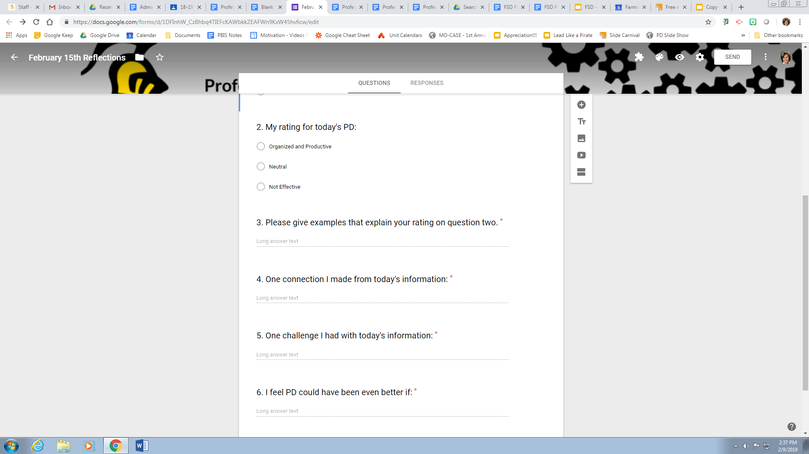
Example of Building Staff Reflection

Slide 13
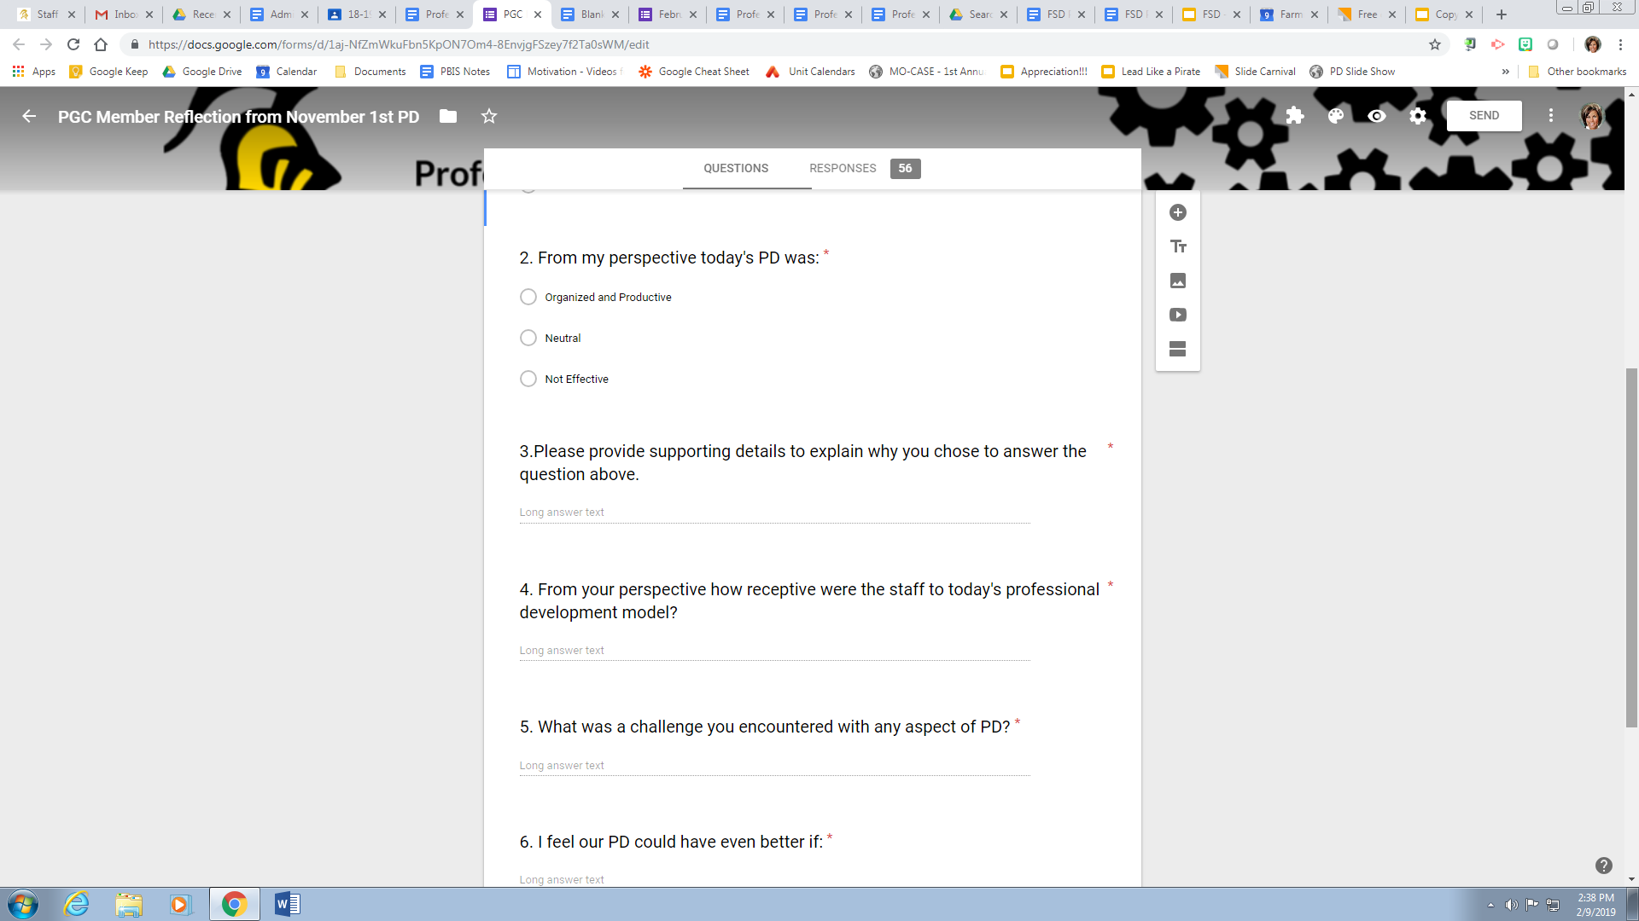
Example of PGC Member Reflection

Slide 14
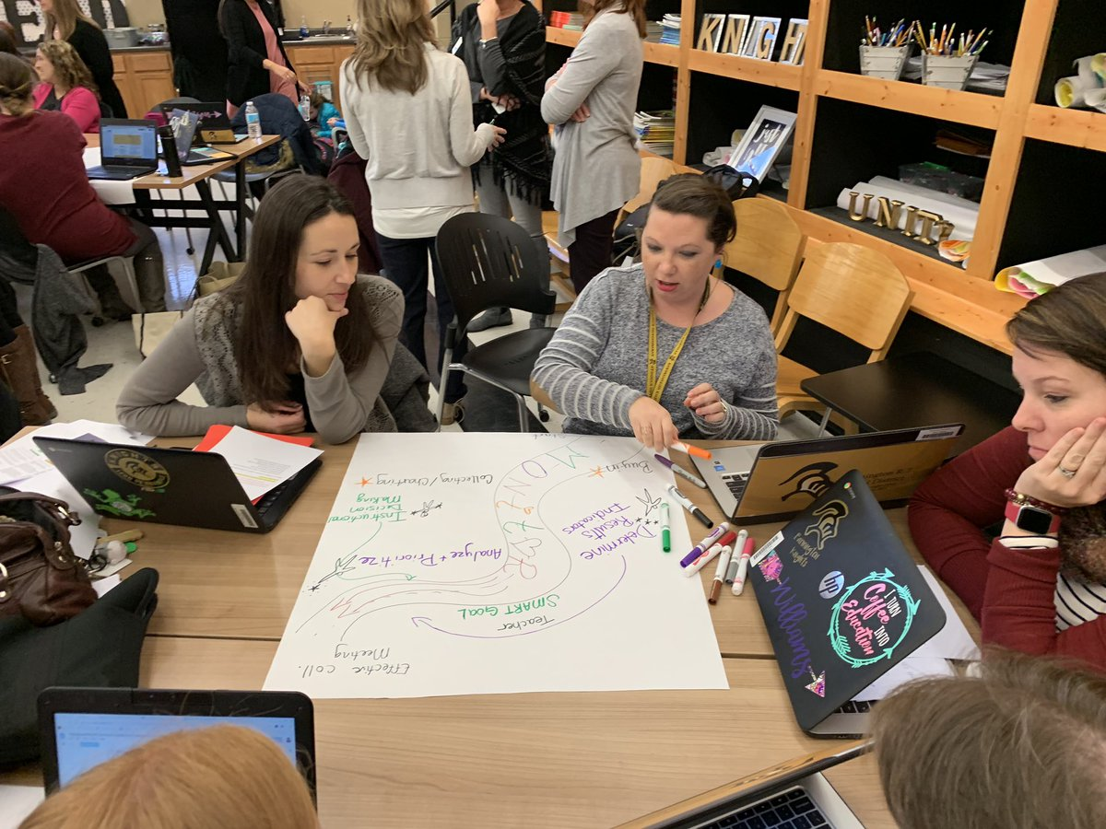
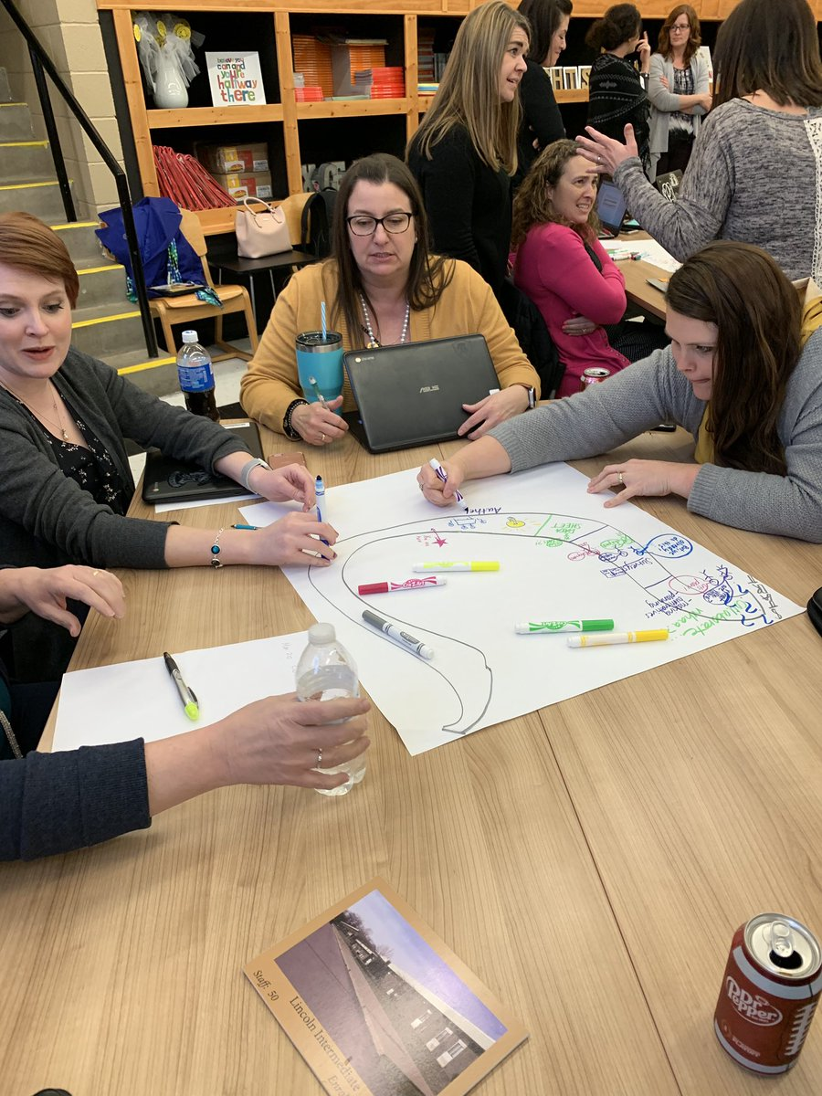
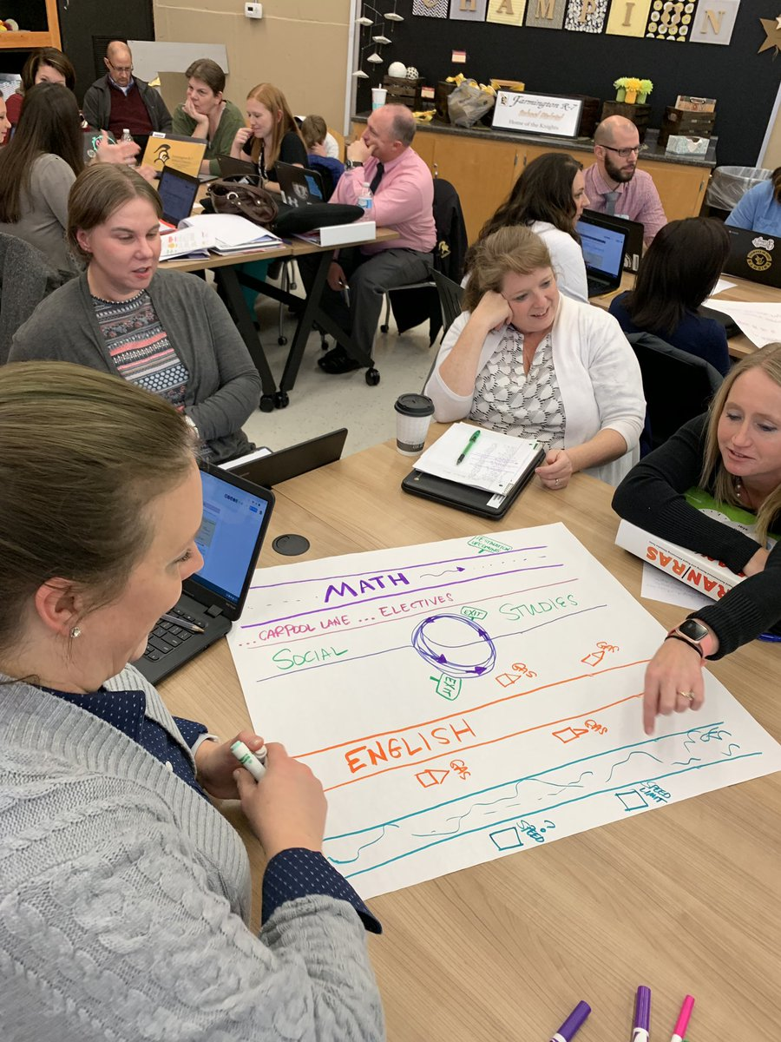
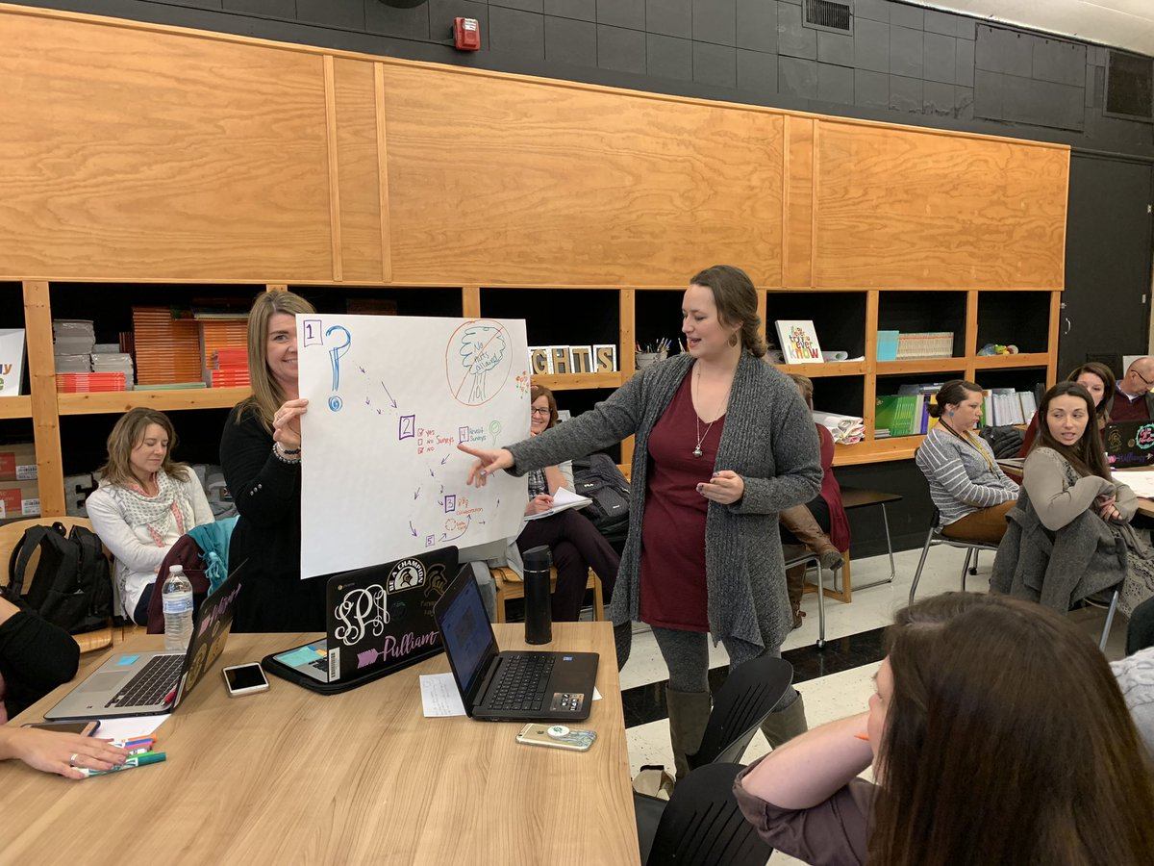
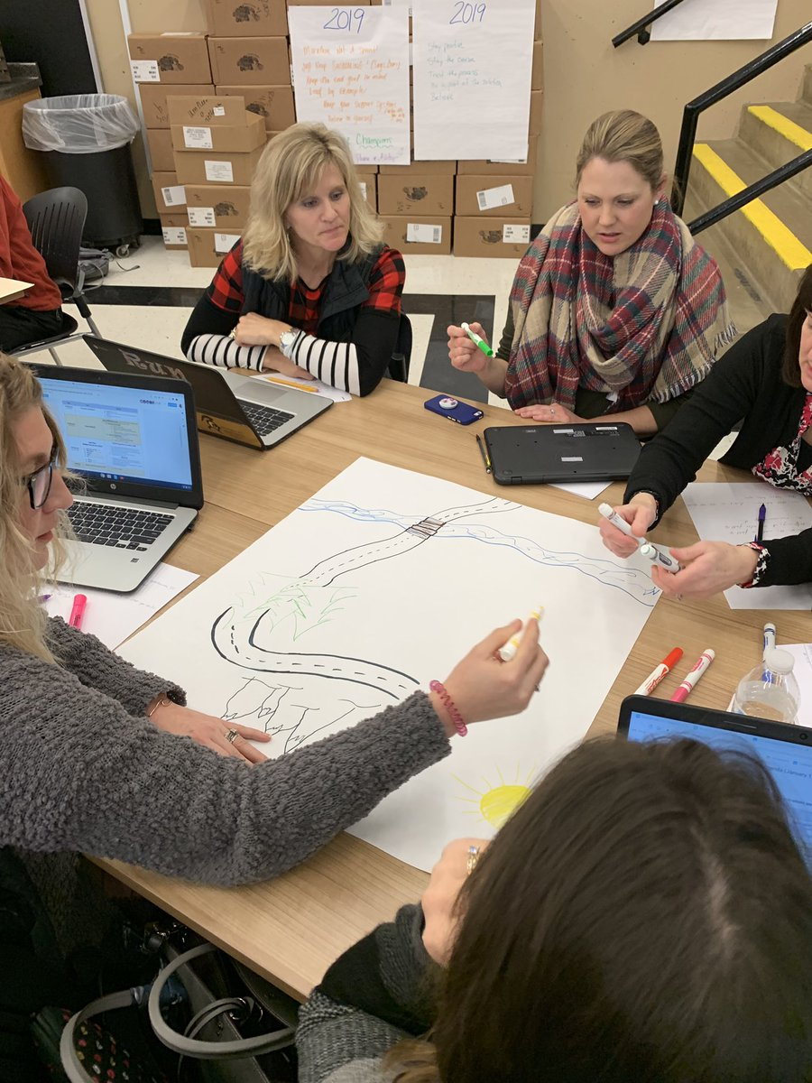
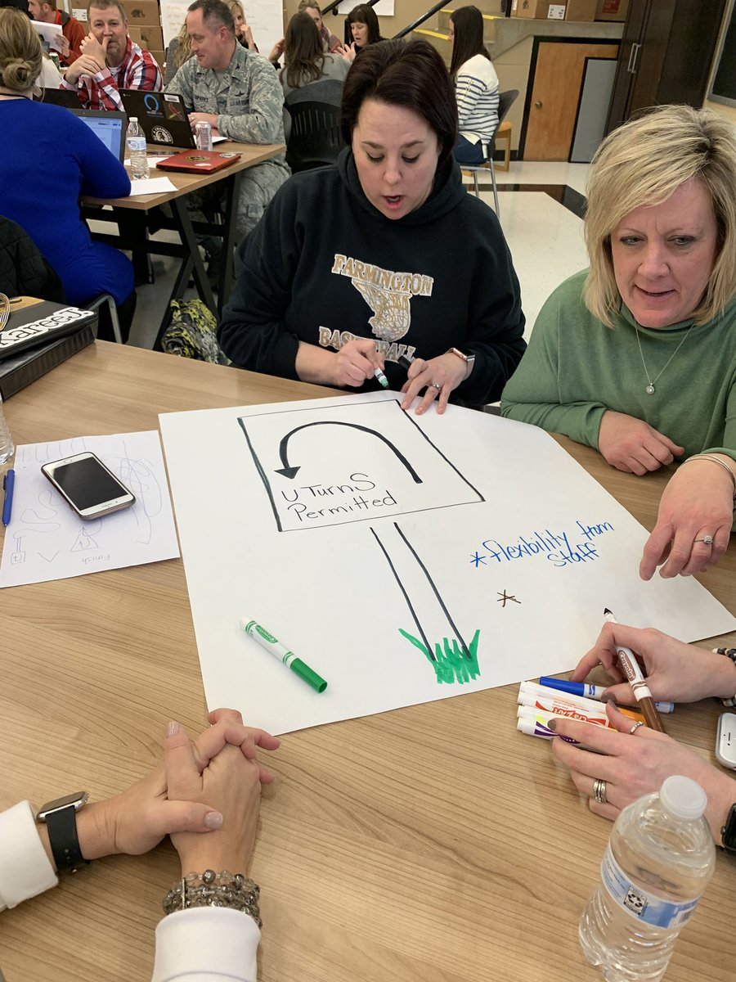
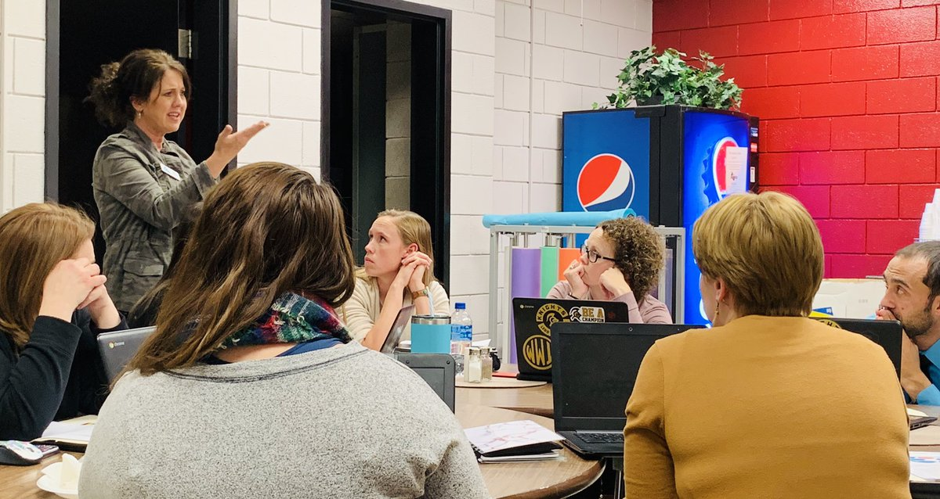
PGC Members in Action

Slide 15
Using the
Mo Edu Sail Website
Tells About MMD/DCI -- The “Why”
Blueprint for Administrators -- The “What”
Content and Resources Available -- The “How”

Slide 16
How FSD used the MoEdu Sail Website in Year #1
Data Based Decision Making
PGC members were given an example of a data collection sheet they could use for collecting student data.
Example
Data Team Agenda
A sample agenda was provided to staff for use when discussing student data. This agenda meets the criteria of the practice profiles of collaboration and DBDM.
Example

Slide 17
FSD use of VLP in 18-19
Different information and links were taken from the VLP to create a document for staff to use as a resource for learning and teaching staff about collaboration and DBDM.
Example

Slide 18
Accessing VLP on DESE Website
Visual For Staff to See How to Get on VLP

Slide 19
Directions for VLP
VLP Assessment Access

Slide 20
Resources
Resources
MORE Resources!
Check out these resources -- VLP
VLP should be your “go to” place
Total success!

Slide 21
What are the Benefits for FSD?

Slide 22
Benefits Chart MMD/DCI
Teacher Leaders | Building leadership capacity into teacher leaders Leading building PD using common resources from the VLP
District Approach | United front with MMD/DCI Meet once a month as a district leadership team
Structures | Helped strengthen our problem solving teams Agenda driven Correct collaboration structures in place
Aligns to MSIP 6 from DESE | CSIP BSIP Teacher Goals Student Goals New Teacher Evaluation System
Notes:
Suggested by steven

Slide 23
The
Overall Approach
DATA
STREAMLINING
Missouri Model

Slide 24
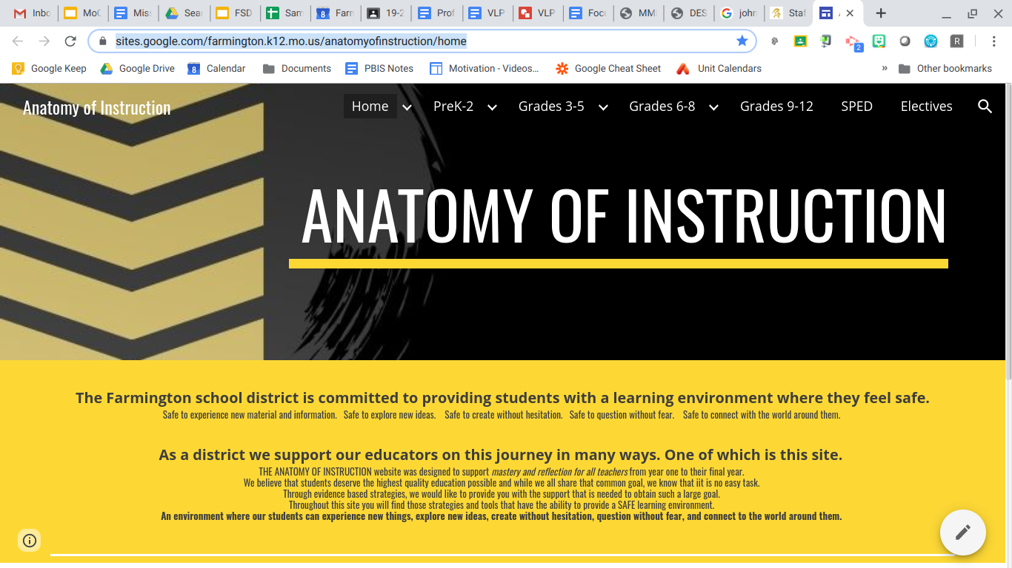
We are working to provide our staff with more resources for instruction that support the MMD/DCI Work
Place your screenshot here

Slide 25
John O’Connor Book
OUR NEXT Exciting STEP
NEED
Recognition of the need to train on specialized instruction

Slide 26
Thanks!
Any questions?
You can find me on Twitter & via email:
@drkrauseashley
akrause@farmington.k12.mo.us

