Slide 1
Compliance and the Art of Evaluation Report Writing
Katie Davis
Psychological Examiner
Francis Howell School District

Slide 2
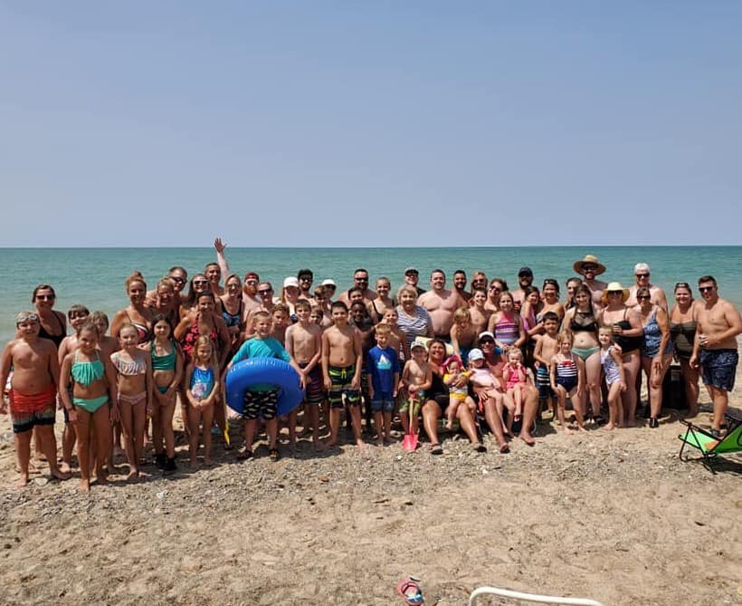
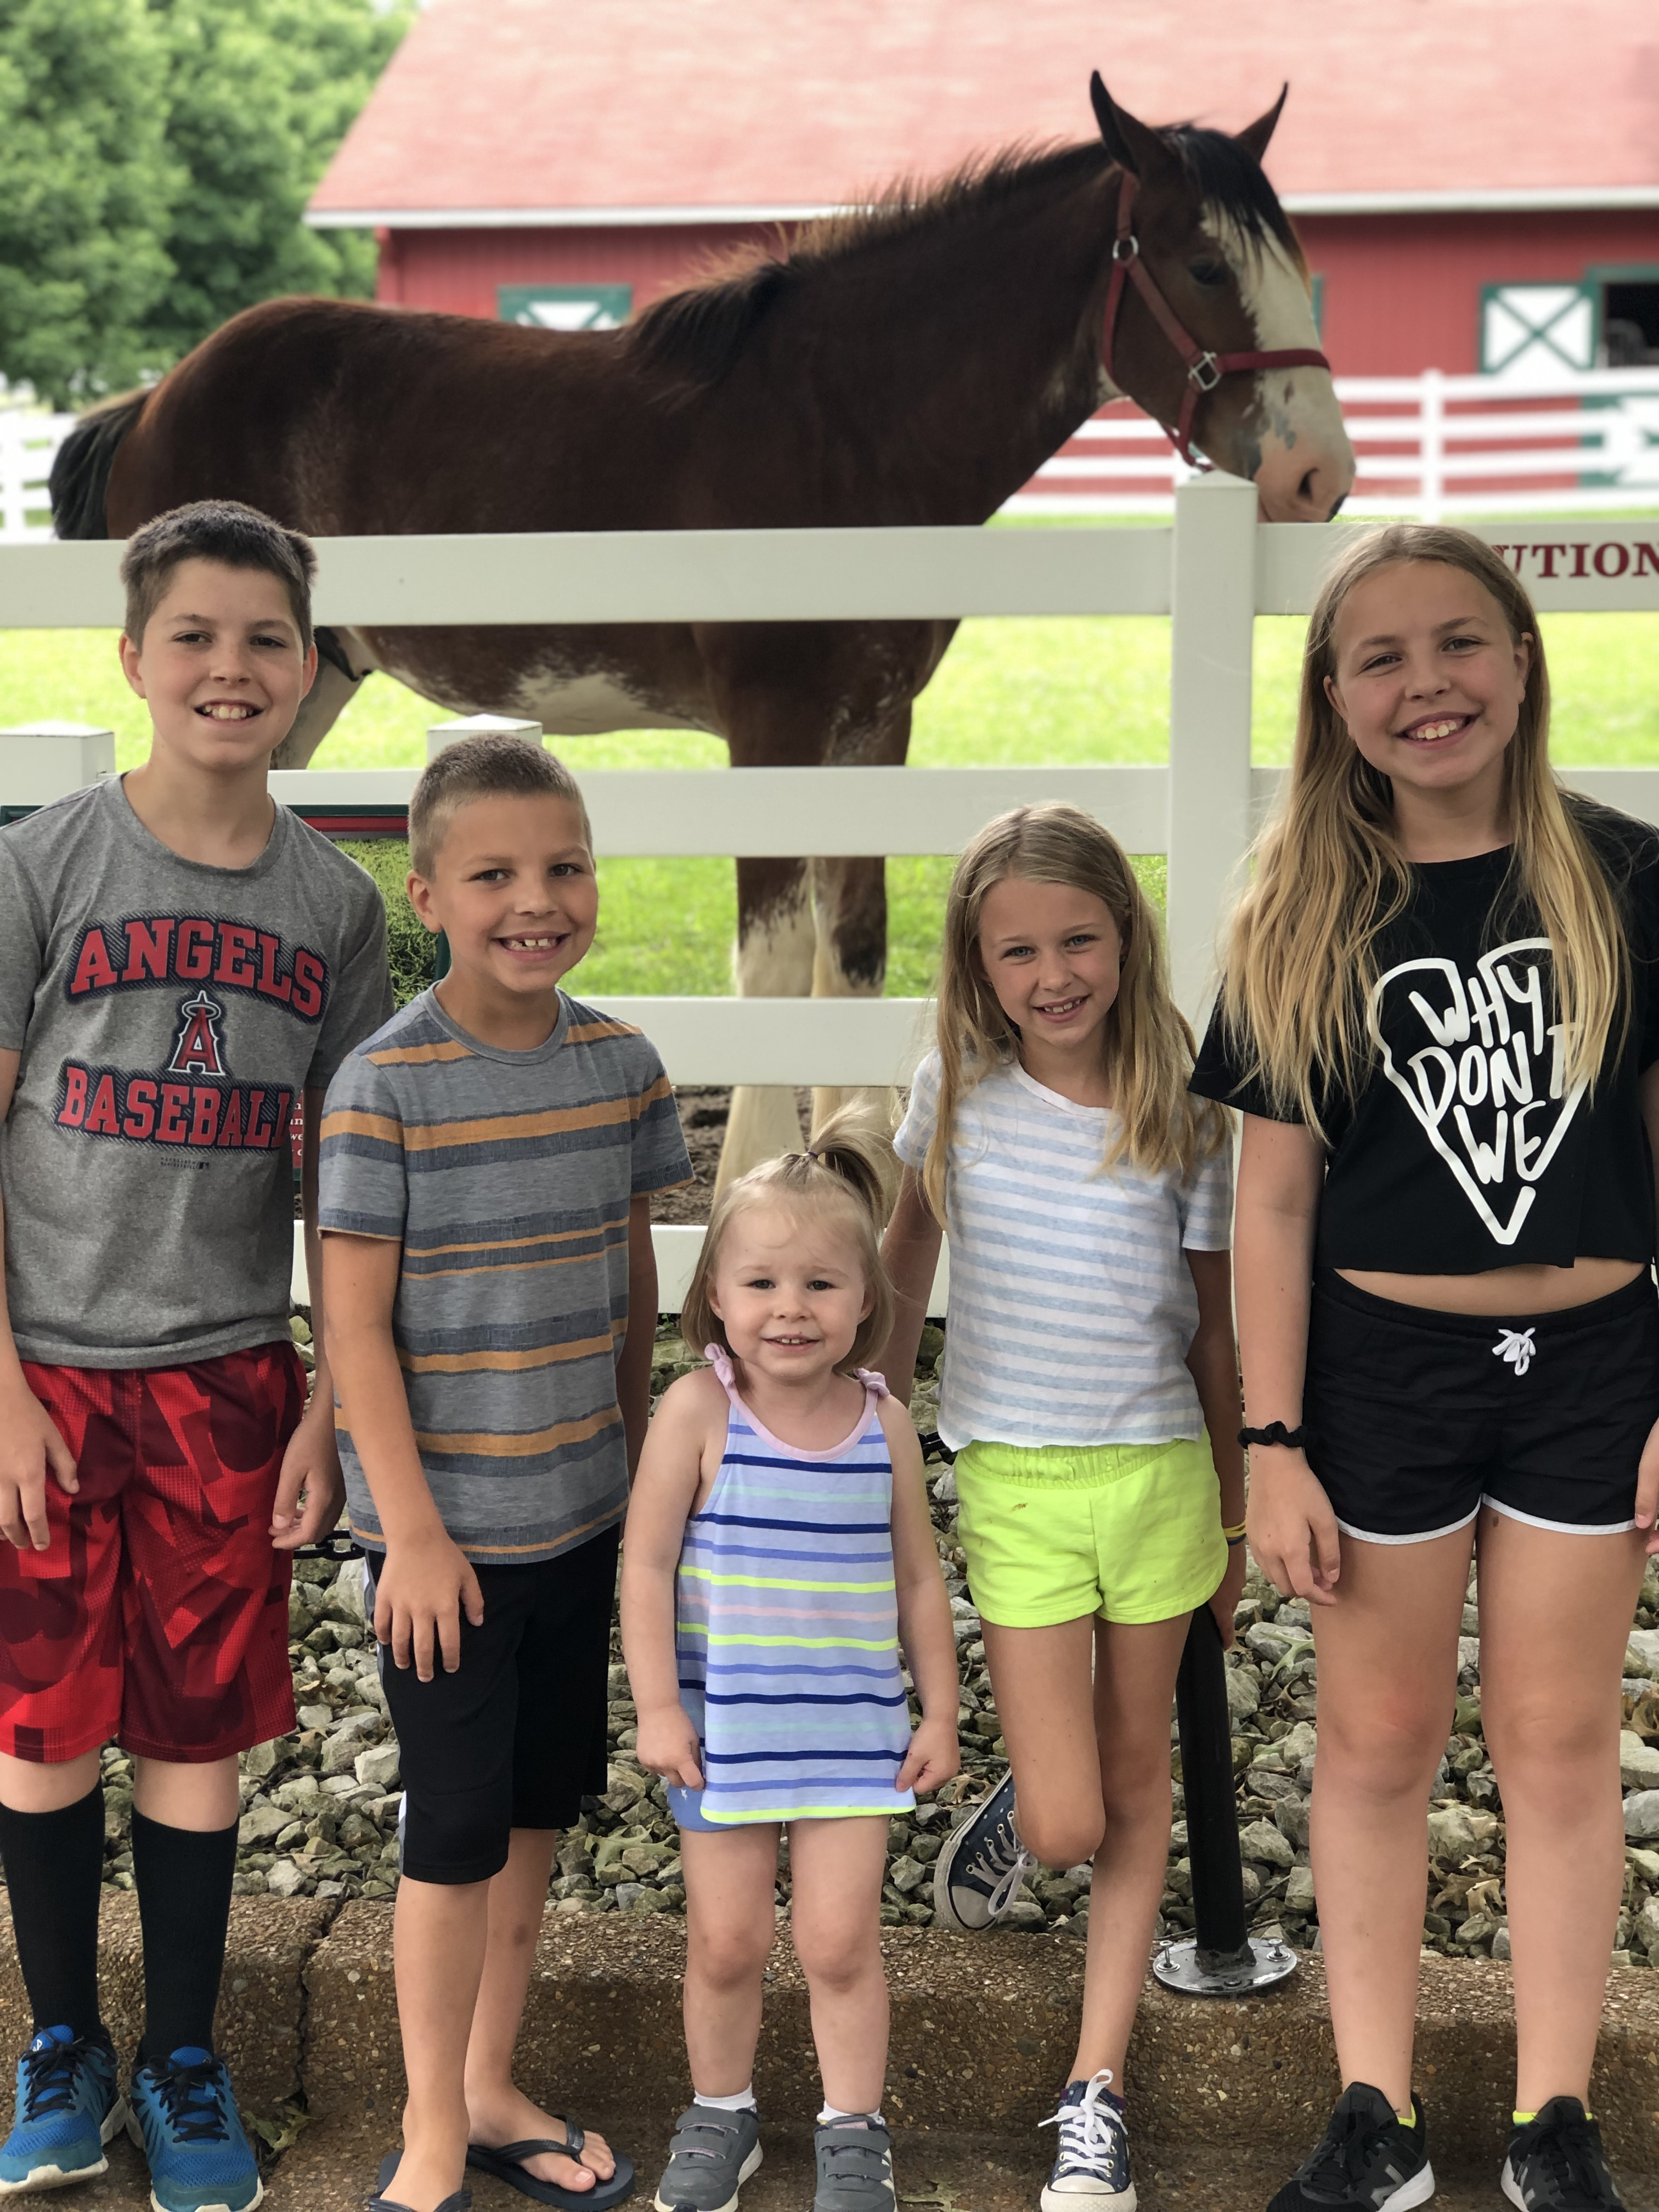
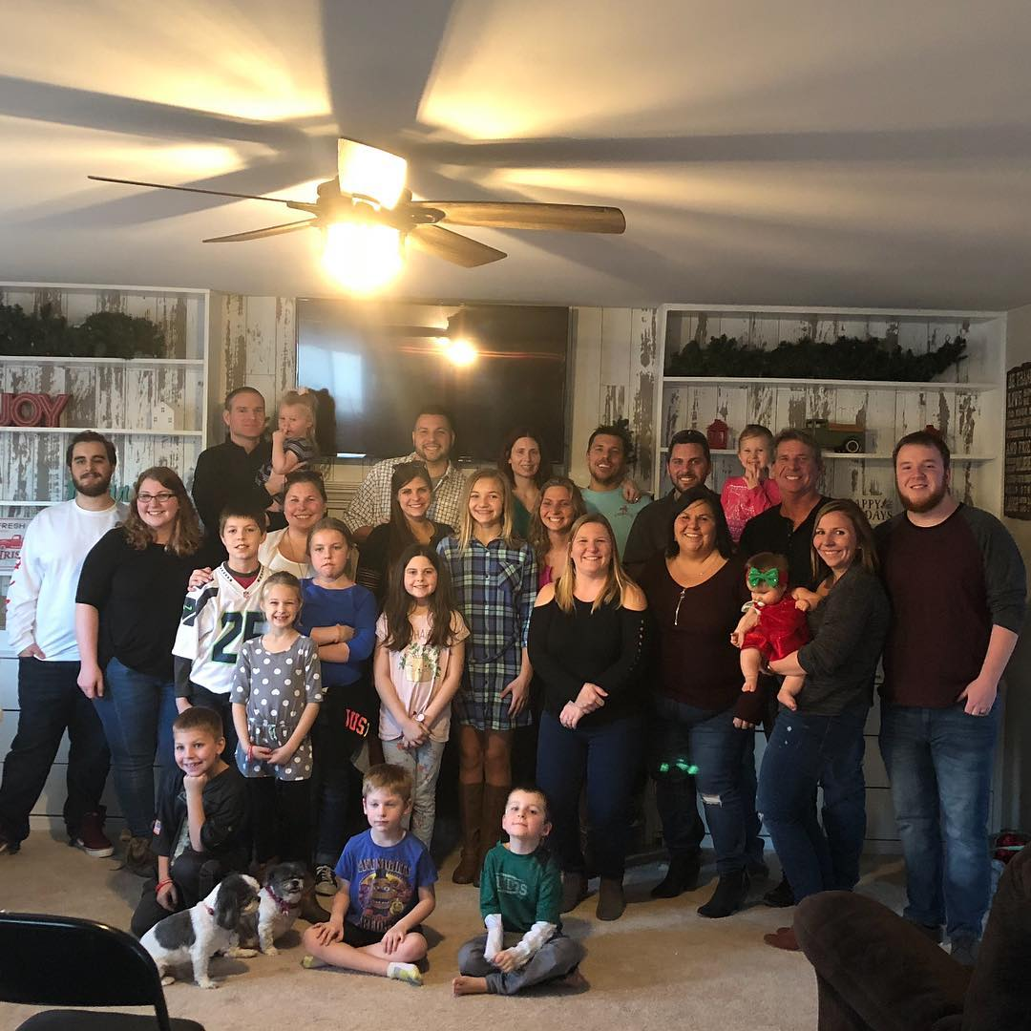
About Me…
6th year as a Psych Examiner
Experience working with students from PK through 12th grade
Currently at Francis Howell School District on the Early Childhood Evaluation Team
Background and Education in School Counseling and Professional Counseling
From St. Louis – born and raised
Lots of kids, and lots and lots and lots and lots of family
Lifelong learner – will go back to school soon!
Organized Type-A Personality

Slide 3
What your reports should be…
Professional…
Technical…
Lots of past tense
Redundant/Repetitive
Passive (e.g., “The following results were obtained:” or “This instrument is designed…” etc.)
Student-First…
Compassionate…
You’re talking about a parent’s pride and joy here! Be nice.
Universal…
You shouldn’t need a college degree to understand what’s being said! Know your audience.

Slide 4
Data sources…
Student Records
Health
Attendance
Discipline
Anything else that’s relevant!
Enrollment History
Previous Evaluations
School, First Steps, DIAL-4, ASQ-3/PAT, Mercy, Knights of Columbus, Sensory Solutions, etc.
Current IEP (or IFSP or ISP – you get the hint), if applicable
Or, just note the current interventions/strategies being implemented!
Assessment Data
MAP, EOCs, Gates, CBM data, and more
Current Grades and/or Progress Report
Parent and Teacher Input
The more information you have, the better your evaluation report will be!

Slide 5
The stranger test…
WHO said it?
WHAT did they say?
WHERE did testing occur?
WHEN was it said?
“Ms. Smith, Joey’s teacher at MOCASE Elementary, reported on 09/23/2019 that…”
or
“Joey was administered the GFTA-3 on 02/22/2018 by an SLP at Sensory Solutions…”
If a stranger reads this, will they get the
WHOLE picture?

Slide 6
BASIS FOR DETERMINATION…
SAMPLE: “The evaluation team used the following information as a basis for this determination: previous evaluation reports, medical information, teacher observations, Review of Existing Data information, current assessment results, and the discussion of the evaluation team. Using the Compliance Standards and Indicators set forth by the Missouri Office of Special Education as a guide, the evaluation team considered the following options: continuing eligibility with the previously-identified educational disability of a Specific Learning Disability, changing Joey’s eligibility to an identification of Other Health Impairment, or releasing Joey from the special education program and deeming him ineligible for any category under IDEA.”
NOW – Talk about why certain options were REJECTED. Explain how the discussion went!
THEN – Explain what decision your team ultimately landed on!

Slide 7
USE THE STANDARDS AND INDICATORS!
The team determined that STUDENT meets eligibility for the special education program under the eligibility area of a Specific Learning Disability in the areas of Basic Reading Skill and Reading Comprehension. This decision is based on the following criteria:
1400.10 – Joey does not achieve adequately for his age or to meet State-approved grade-level standards in the following areas when provided with learning experiences and instruction appropriate for his age or State-approved grade-level standards
1400.10.a. Basic Reading Skill
1400.10.b. Reading Comprehension
1400.20 –
1400.30 –
1400.40 –
1400.50 –
1400.60 –
See handouts!

Slide 8
And finally…
Seriously, humor me.

Slide 9
The nit-picky stuff…
Don’t Use These | Use These Instead
Received | Obtained (It’s not a gift!)
Feels/Thinks | Reported, Stated, Indicated, Expressed Concern, Explained
Present Tense | Past Tense
“Mom said” (too informal) | “Joey’s mother reported” or “Ms. Jones indicated”
His score was one standard deviation below the mean… | Joey obtained a standard score of __, indicating performance within the Below Average range or which falls at the ___ percentile rank.
He was unable to/He cannot | Joey has not yet demonstrated the ability to… or Joey was not observed to…
Joey struggled with… | Joey demonstrated difficulty with…
Always/Never | DO NOT USE. These absolute/extreme statements catastrophize student’s abilities.
A combination of 1/4/10, 01/04/2010, January 4th, 2010, and 1-4-10 | PICK ONE – and be consistent throughout (Personal Bias: MM/DD/YYYY decreases potential for mistakes/typos)
IFSP from 2/16/14: | “According to the IFSP report dated 02/16/2014…”
CUT AND PASTE FROM LAST REPORT | Summarize previous test results; be brief and concise; hit the big points.
This score places Joey in the Average range. | This score indicates performance within the Average range.
NO CONCERNS. | Explain strengths and weaknesses. If it’s all good, just state the positive!

Slide 10
Questions?
E-mail, Call, or Text Me!
Katie Davis
katie.davis@fhsdschools.org
Office: (636) 851-5978
Cell: (618) 567-4214

