Slide 1

What is an Evidence Based Intervention? Choosing and Implementing Academic and Behavior Interventions That Work.

Slide 2
The current dilemma for educational professionals
1) Problem Solving Models (RTI) essentially mean interventions for everyone in need
  Essentially any child not responding is considered in need.
2) No Child Left Behind and IDEIA mandate accountability, or that we have defensible outcome data on all interventions
3) Traditional models have been focused on spending a great deal of time coming up with recommendations about a child's needs
  Assessment orientation – Hours of assessment and report writing followed but meeting time
  Traditional Consultation orientation – A number of consultation sessions allowing a consultee to come up with intervention idea

Slide 3
The current dilemma for educational professionals
So…
  More cases
  Higher levels of accountability
  And traditional methods assume there is lots of time…

Slide 4
Selecting Interventions Quickly: “The Reasonable Hypothesis"
Time is a precious commodity. Educators need to be efficient when problem solving.
Under many circumstances, the most efficient thing to do is to test the easiest hypothesis first, implement an intervention, and monitor and evaluate outcomes.
If that approach fails to improve student performance, then something progressively more time intensive can be attempted until the probable cause of failure is identified.
  Also, easier solutions are more likely to be implemented consistently while solutions which are more time consuming or technically difficult for teachers and support personnel are less likely to be implemented correctly (Gresham, 1989).

Slide 5
What are EBI in Schools?
Tier 3 (5%)
Functionally Based EBI
Tier 2 (15%)
Functionally Related Small-Group and Individual EBI
Tier 1 (80%)
Evidence-Based Curricula
Tier I EBI – Whole school best practices
Tier II EBI – Functionally Related Small Group Practices
Tier III - Individually Functionally Based EBI
NOTE – EBI are a very different thing in Tiers 1 and 2 than Tier 3! This is a critical and not well understood issue…

Slide 6
Tier 2 and 3- EBI Fine Print I
EBI are validated for a specific purpose with a specific population
Implication
  EBI are only useful for a range of problems and as such, must be paired up with the right situation
    A hammer is an effective tool, but not with a screw

Slide 7
Tier 2 and 3 - EBI Fine Print II
EBI assumes implementation integrity
Implication
  Changing parts of an intervention, while typical, can invalidate the EBI
  Ways to change an intervention
    Frequency
    Materials
    Target
    Style
    On and on and on….

Slide 8
Tier 2 and 3- EBI Fine Print III
EBI are typically validated with large group research, or a series of small group studies
Implication
  EBI have been documented as likely effective, not surely effective
  Even the most effective interventions are often ineffective with a specific case
  As such, you cant assume an EBI will always work

Slide 9
Implications of the Fine Print
A list of EBI is just a nice place to start
Additional steps
  Need to select EBI that make sense for the current case
  Need to implement the EBI with integrity
  Need to evaluate the effectiveness in some manner to see if it worked

Slide 10
General Goal of Intervention Selection
Make a sound decision quickly
Try the selected intervention
Evaluate the intervention
Recycle/escalate if necessary

Slide 11

The Evidence Based Intervention Network

Slide 12
The Evidence Based Intervention Network
Created and maintained by the MU, IU and ECU School Psychology Programs
Presents EBI associated with the 5 common reasons for academic and social behavior problems each year
http://ebi.missouri.edu

Slide 13
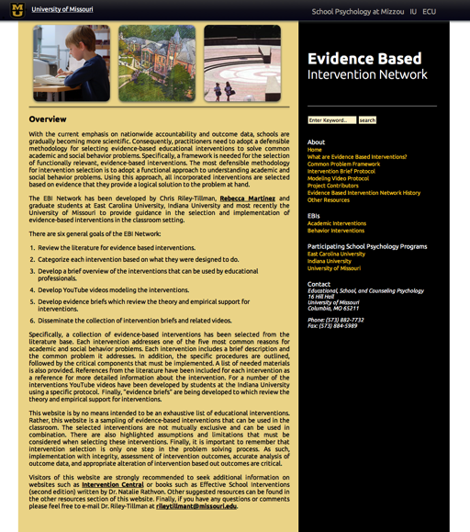
EBI Network Main Page

Slide 14

EBI Network Academic Interventions Page

Slide 15

EBI Network Behavioral Interventions Page

Slide 16
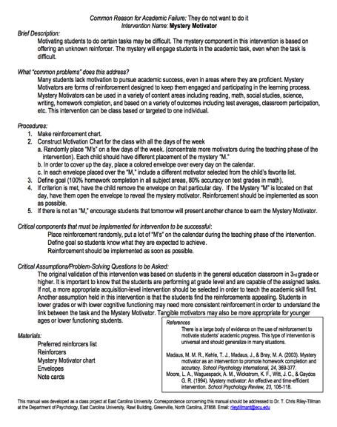
EBI Network Sample Intervention Brief

Slide 17
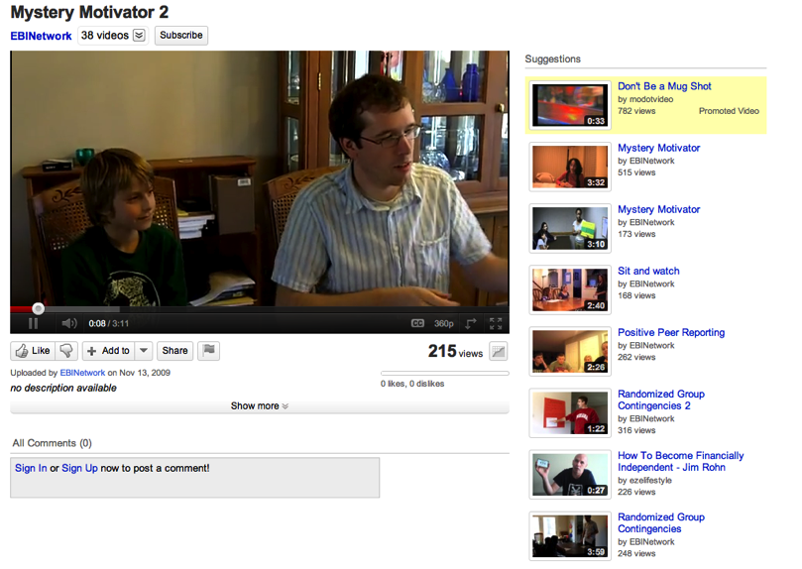
EBI Network Sample Intervention Modeling YouTube Video

Slide 18
Using the EBI Network For Tier 2 and 3 Interventions
Using this model, a teacher or problem solving team is asked to consider what they think the most likely reasons are for the academic or behavior problems.
  Once selected, these hypothesized reasons are then used to select interventions.
  If there are more than one likely reasons selected, they should be rank ordered (from most to least likely).

Slide 19
Using the EBI Network For Tier 2 and 3 Interventions
Selected interventions should be customized to the teacher with care not to alter the function
  Change the icing – not the core ingredients
Implement
Collect Outcome Data
Analyze
The true documentation that an intervention is "evidence based" for a specific case occurs only when there is outcome data indicating a change in the target behavior.

Slide 20
Functional EBI Selection with Extended Analysis or
Practical Functional Assessment/Analysis

Slide 21
Let’s Talk About “Functional Assessment”
What does this term refer to?
What does this look like in practice?
What happened to the “analysis”?

Slide 22
School-based Functional Assessment in 2012
A “high incidence” approach
  Flexible rather than prescriptive
  Focused on “Intervention effectiveness” rather than functional documentation
  Multi Function
Followed by functional analysis rather than done in isolation

Slide 23
Common Reasons Why Students Misbehave
Classwide problems
Student has not learned the behavior
Inappropriate behavior removes student from what they do not want to do (escape)
Inappropriate behavior gets the student something (typically attention)
They have not had to do the behavior in that way before

Slide 24
Selecting EBI’s that Align with Function
Examples :
Good Behavior Game
Check In Check Out (CICO)
Non-contingent reinforcement (NCR) – attention seeking
Antecedent modification – escape
Instructional Match -- pre-requisite or skill / ability
http://miblsi.cenmi.org/
Notes:
What we’re going to do in the next section is discuss a few important considerations when delivering intensive interventions and then give you a few specific classroom examples that address escape, attention and instruction cases. Please refer to Handout 3 – Examples of EBI’s. There are four examples in total we will review.
CICO
NCR
Antecedent Modification
Instructional Match

Slide 25
Classwide Problems
Sometime multiple children in the classroom are exhibiting similar behavior problems.
Solution: A classwide behavior intervetion!
EBI Network Intervention: Good Behavior Game
  http://ebi.missouri.edu/wp-content/uploads/2011/09/Good-Behavior-Game.pdf

Slide 26
Selecting EBI’s that Align with Function
What is Check in Check Out (CICO)?
  Empirically supported strategy for reducing problem behavior
  Relatively quick & easy; provides structure
  Increases positive adult contact
    Excellent intervention when function of behavior is attention seeking
    Also useful for kids who escape because they don’t want to do a task if teach praise is more reinforcing than the task is punishing
http://miblsi.cenmi.org/
Notes:
CICO is one intervention with many names – e.g. The Behavior Education Program (BEP); Check, Connect, and Expect; Hello, Update, Goodbye (HUG)
Listed are some of the key features of CICO:
Check-In Check-Out (CICO) is commonly used because of the research-base supporting the positive impact for students. It is also a quick and easy intervention that requires minimal amounts of time before and after school and provides that predictability and structure to the students’ day. It increases the frequency of positive adult contact for the student that is structured to encourage, motivate, and support the student
CICO is LIKELY TO WORK when the reason or purpose of the behavior is tied to or because a student is wanting attention of some kind (e.g. the function of behavior is attention based). It is a functionally derived intervention but in order for it to be TRULY FUNCTIONALLY EFFECTIVE, the function of the behavior has to be attention based in some way – otherwise, it will be ineffective.

Slide 27
Selecting EBI’s that Align with Function
CICO Elements
Focus on teaching
Check-in/Check-out System
Daily classroom report card
Home-School partnership
Collaborative team-based process
http://miblsi.cenmi.org/
Notes:
We’re not going to go over all the elements in today’s presentation but your handout has a few more details about CICO and if you would like to learn about all the different elements, please refer to the MiBLSi website and there is a section specifically for CICO.
Their website details are in the corner of each of the slides, on the handout and on Slide __ (38?)

Slide 28
Selecting EBI’s that Align with Function
Who is CICO for?
  Engages in externalizing behaviors
  Less than 15% of students
  Students with multiple referrals (2-5 majors)
  Students who receive several “minor” referrals
  Students who receive referrals in multiple settings
  Students who find adult attention rewarding
http://miblsi.cenmi.org/
Notes:
CICO is a commonly used Tier 2 intervention and this is a good place to start but when it comes to those students who need intensive intervention – this may not be enough on its own. Typically, en route to a Tier 3 Intervention, you can implement individual level changes such as change CICO adult, add peer support, add extra ‘check-in’ etc.

Slide 29
Selecting EBI’s that Align with Function
Benefits of CICO:
  Increased structure, feedback and adult support on a daily basis
  Daily home/school communication and collaboration
  Data is collected, reviewed and used to make decisions about the intervention success (or lack there of)
http://miblsi.cenmi.org/

Slide 30
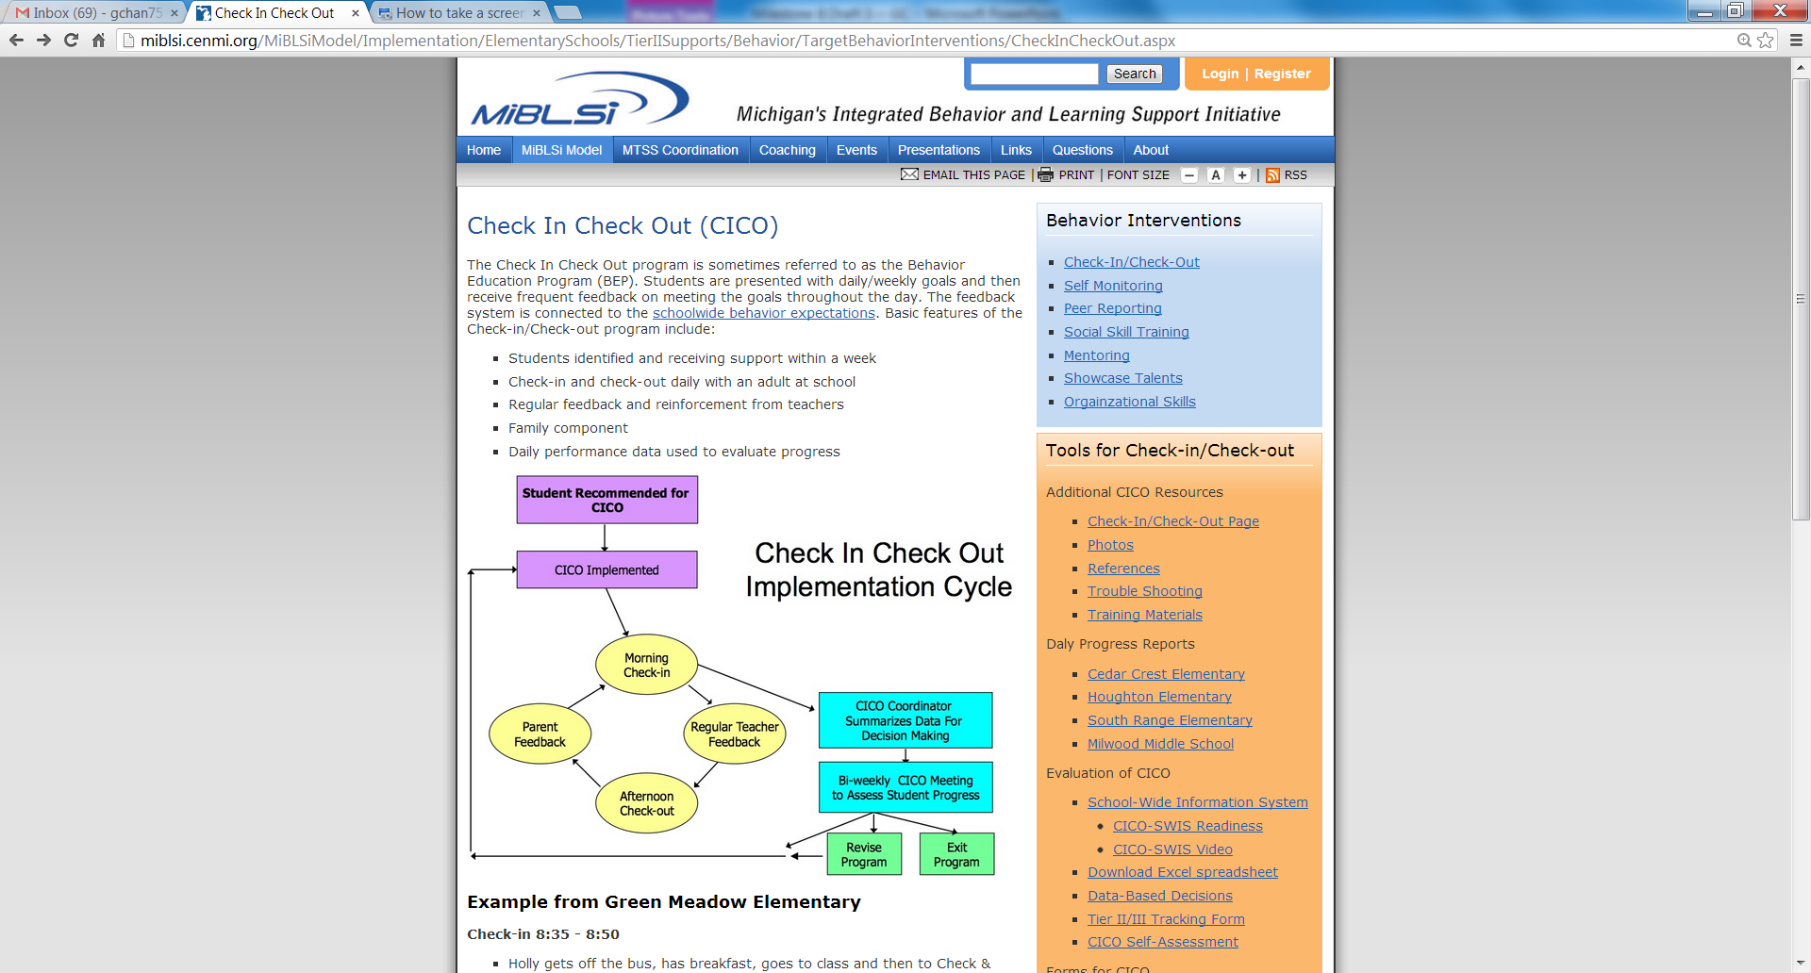
http://miblsi.cenmi.org/
Notes:
All this information about CICO is available on the MiBLSi website.

Slide 31

Selecting EBI’s that Align with Function
Non-contingent reinforcement
(NCR)
Notes:
This is a visual example of NCR. Hopefully this picture looks familiar like something you’ve seen in your own classrooms etc. This picture was borrowed from google images for illustrative purposes only but does anyone recognize our little friend and let’s call him Johnny?
CLICK TO SHOW ARROW
Remind participants NCR is Example #2 in Handout 3: Examples of EBI’s.

Slide 32
Selecting EBI’s that Align with Function
Brief Description of NCR:
  NCR is a powerful method to reduce problem behavior. NCR involves giving the student access to a reinforcer frequently enough that they are no longer motivated to exhibit disruptive behavior to obtain that same reinforcer.
        e.g. saturate the environment with the reinforcer BEFORE the behavior occurs
ebi.missouri.edu
Notes:
Read the slide.

Slide 33
Selecting EBI’s that Align with Function
  Example: Student wants teacher attention and calls out or engages in disruptive behaviors to get attention consistently during a group activity like art or story time.
  Possible Solution: Teacher will provide appropriate attention prior to the child “asking” for attention with the “problem behavior” – e.g. have the student sit with the teacher while she is reading the book
Notes:
Review the example and work through it with the group (e.g. pairs, small groups, teams, etc.)

Slide 34
Selecting EBI’s that Align with Function
Critical Components for Success:
You need to identify the reinforcer for the problem behavior – It will NOT WORK if you do not know the function of the disruptive behavior
  The problem behavior must be attention seeking
You need a schedule for delivery of NCR that minimizes problem behavior
  NCR is most effective with a heavy dose of reinforcement early in the day
Must ignore problem behavior once schedule is initiated
Should fade the process as problem behavior declines – but make sure child doesn’t reengage in behavior by fading too quickly
  Slowly reduce the amount of NCR given. NOTE – NCR is good teaching practice so it should never be “stopped”
Notes:
Other possible discussion points.
What should they do if student re-engages in behavior -- #4?
Go back to higher rates of NCR
How will teams know the intervention is working?
Decrease rates of problem behavior
What data should teams collect and review?
Ideally some estimate of the problem behavior. Daily behavior ratings are idea, as are a frequency count.

Slide 35

Selecting EBI’s that Align with Function
Antecedent Modification
http://ebi.missouri.edu/
Notes:
Handout 3– Example #3

Slide 36
Selecting EBI’s that Align with Function
Brief Description on Antecedent Modification:
  The student doesn’t have to do something when they exhibit the problem behavior
  The problem behavior is “working” for the child by allowing them to escape something they don’t want to do.
http://ebi.missouri.edu/
Notes:
Read slide on Antecedent modification.
Antecedent modification is typically associated with escape based behaviors.

Slide 37
Selecting EBI’s that Align with Function
Example:
      Student wants to escape a non-preferred activity such as math or gym. Every time the teacher announces the start of the specific activity, the student starts engaging in disruptive behaviors (e.g. runs away, shouts out, pretending to sleep, etc.)
http://ebi.missouri.edu/

Slide 38
Selecting EBI’s that Align with Function
Possible Solutions (4):
    Minimize need for the escape by making the target activity less punishing!
    Alter antecedents to increase task engagement, appropriate behaviors and general success
          For example, pre-teaching, offering choices and modeling
Notes:
TCRT + GC to add speaker notes here – RZ suggestion; clearer explanation of sample procedures of illustrative case?
If we return the example of the student who engages in disruptive behavior every time a specific activity occurs and the hypothesized function has been identified as escape, what’s next? What are some of the possible questions you can ask so that you can take the next steps and ensure that the solution or strategy you choose is one that will likely be effective because it is tied directly to the function of the behavior?
Escape motivated behavior like attention based behavior happens for different reasons and exists along a continuum. As a general rule, to decrease escape behavior, the activity needs to be less punishing from the student’s perspective. And what we mean by punishing is that the activity is or has become aversive to the student and they would rather engage in an INAPPROPRIATE behavior than engage in the activity.
Depending on the type and intensity of the “escape” behavior, there are a few strategies / changes that are likely to help – changing the antecedents to increase engagement in the activity or success with the activity. For example, you can pre-teach necessary skills; offer choices; model behavior; breakdown tasks, etc.

Slide 39
Selecting EBI’s that Align with Function
Critical Components for Success:
  Positive reinforcement (e.g. praise) for engaging in activity
  Reinforce appropriate behaviors in shorter intervals initially (e.g. change the schedule of reinforcement or task demand)
http://ebi.missouri.edu/
Notes:
Altering the antecedent of the target behavior has the substantial advantage of being proactive. As such, with appropriate modifications of the antecedents, a problem behavior (e.g. disruptive behavior or task demand refusal) can be avoided. For students who want to escape non-preferred activities, altering antecedents can increase task engagement. Antecedent-based procedures can be used to decrease inappropriate behaviors or increase appropriate behaviors.
Provide positive reinforcement for participating in the activity, redirect / provide instructional feedback that you can follow up with – it’s critical that strategy addresses the function of the behavior (e.g. Instead of having to do a page of math problems independently before accessing some kind of reinforcer, maybe the student only has to do 5 math problems)
TCRT+GC add speaker notes here – RZ suggestions. How will teams know this is working? How do you measure progress?

Slide 40
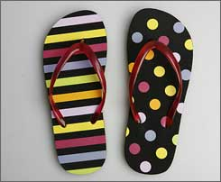

Selecting EBI’s that Align with Function
Instructional Match
Notes:
Remind participants that information is available in Handout 3 . Instructional match is example #4 in the handout.

Slide 41
Selecting EBI’s that Align with Function
Brief Description / Function
  Escape behavior related to academic task that are simply “Too Hard” -
    The student might not be successful because the instructional materials are too difficult or they may not have the pre-requisite skills
http://ebi.missouri.edu/
Notes:
Read slide on Instructional Match.

Slide 42
Selecting EBI’s that Align with Function
  A mismatch between student skill and level of difficulty of task – the assessment of a student’s current instructional level is INACCURATE in some way (e.g. knowledge, difficulty, pace, level, etc.)
  Children who are failing academically are frustrated and often act out!
Notes:
Read slide.

Slide 43
Selecting EBI’s that Align with Function
Examples:
Addition math problems without being able to count
Journal writing without being able to form 2-3 word sentences
Drawing without fine motor skills like pencil grip
Running without proper gait
  can only walk on tippy toes
Possible Solutions:
Pre-teach content / skill
Reduce the task difficulty
Breakdown tasks into smaller more manageable subtasks
Curriculum based assessment or measurement to determine appropriate instructional level
http://ebi.missouri.edu/
Notes:
Read slide.
Activity: Ask the group or do a think / pair/ share about which solutions they might pair with each example and why.

Slide 44
Selecting EBI’s that Align with Function
Critical Components for Success:
  Must be able to accurately assess student’s CURRENT level of ability AND implement a curriculum and teaching materials that are appropriate to the student’s instructional level
  Must MATCH task demands and with current skill level to ensure success
  Differentiate instruction whenever possible and appropriate
http://ebi.missouri.edu/
Notes:
Other discussion points
How will teams know when this is working?
Decreased problem behavior AND increased academic engagement. It is likely that the academic success will occur prior to or concurrent with the change in behavior.
How will progress be measured?
This is a rather unique “behavior” intervention in that the first line of assessment is academic and/or academic engagement. Direct academic assessment (e.g. CBM) and formative assessment of engagement and the problem (Direct Behavior Ratings) are ideally suited to these cases.

Slide 45
Learned Helplessness Studies
(Seligman & Maier, 1967)
Selecting EBI’s that Align with Function
Underestimate performance, behavior problems
LOW motivation, expectations, perceived control, confidence
Repeated failure + generalization of failure
learned helplessness response style
Focus on limitations, weaknesses
Notes:
Talk about the parallels between the learned helplessness studies with dogs -- Seligman & Maier, 1967 (shocking in cages w no escape – in time causes withdrawal mixed with highly aggressive behavior)
Learned helplessness also extends to human behavior. Let’s take an example at the classroom level which is related to instructional match and the importance of making sure that tasks are matched to skill and ability. Students who are asked repeatedly to do work / tasks that they cannot do and fail at consistently will over time focus on weaknesses, limitations, underestimate their own performance and develop a learned helplessness style. Once in this cycle, it can become self- perpetuating and repeated failure intensifies learned helplessness which can over time causes a range of behavior from withdrawal to externalizing behaviors such as outbursts, etc.
Note that we all think that what was done to the dog is cruel…AND that we think it is cruel to do a similar thing to children!

Slide 46
Problem Solving Materials

Slide 47
Problem Solving Materials
Continued

Slide 48
Where to More Find Interventions
Where to Find More Interventions
  In the classroom (Riley-Tillman and Chafouleas, 2003)
    Certain treatments are more effective
    Certain treatments are more relevant
    Treatment integrity is key
    Interventions need to be tailored
    Interventions are more variable than effective
Texts such a Rathvon’s Effective School Interventions
Web resources for evidence-based intervention strategies
  Big Ideas in Beginning Reading (U of Oregon): http://reading.uoregon.edu/
  What Works Clearinghouse (US Dept of Education): www.w-w-c.org
  Intervention Central: www.interventioncentral.org

Slide 49
Back to the RTI Focus
Considering the nature of EBI – what role does “function” and “integrity” play in a “non-responder”?
How do we deal with this issue?

Slide 50
Intervention/Functional Analysis
Identification of Hypothesized Function
Selection of Relevant Intervention
Implementation of Intervention
Assessment
Analysis Focusing on Both Effectiveness and Function
If Necessary
Keys
  Model combine two issues, function and intervention
  It is assumed that most cases will be multi function
  It is assumed that interventions will be altered in the natural environment

Slide 51
Contact Information
T. Chris Riley-Tillman, Ph.D.
Educational, School, and Counseling Psychology
16 Hill Hall
University of Missouri
Columbia, MO 65211
education.missouri.edu/faculty/ESCP/Riley-Tillman_T.Chris.php
Direct Behavior Rating: www.directbehaviorratings.com
Evidence Based Intervention Network: ebi.missouri.edu

